Slide 1
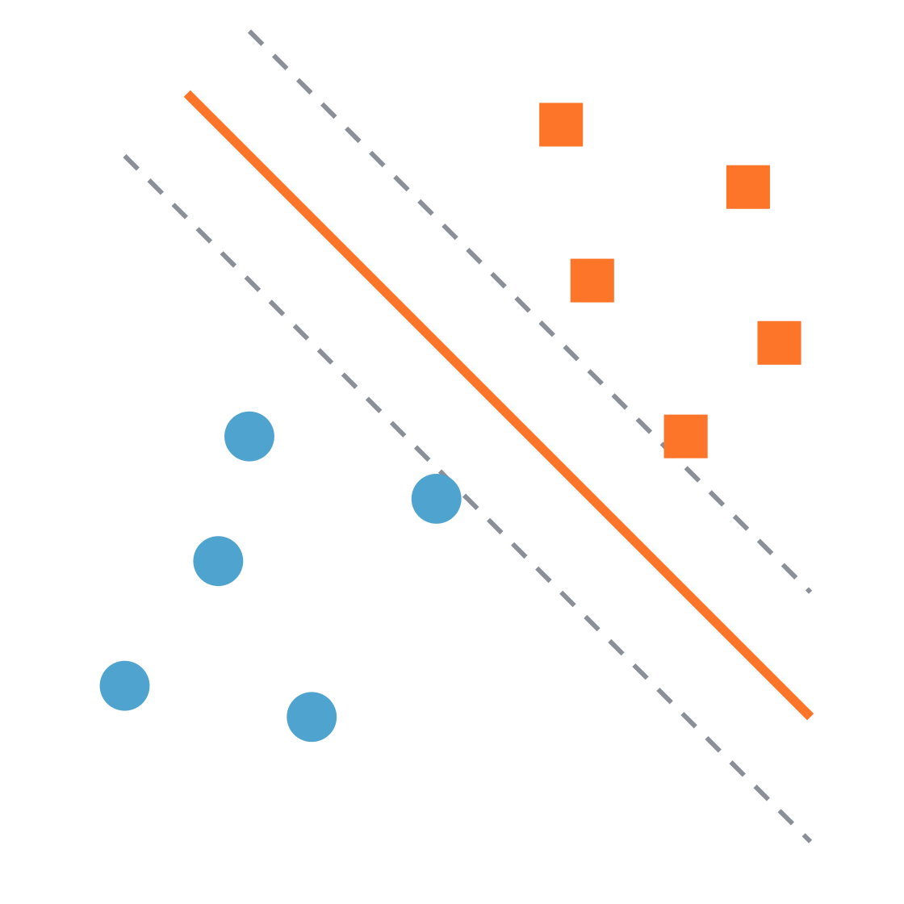
Support vector machines
Practical machine learning
Finding the widest street between two classes
Notes:
Welcome. Today we learn one classifier, SVM, built up in four small steps. The picture on the right is the whole idea: two groups of points, and a line that sits in the middle of the widest empty street between them. By the end, every part of that picture will have a name.

Slide 2
Four ideas, one after another
Roadmap
01
02
03
04
Maximum margin
Support vectors
Soft margin and C
Kernels
Pick the line with the widest street
Only the points on the edge matter
Allow a few mistakes, at a price
Bend the boundary when a line is not enough
Support vector machines · Practical machine learning
Notes:
Each step answers a problem raised by the previous one. Step 1: many lines separate the data, so which one? Step 2: which points decide that line? Step 3: what if the data is messy? Step 4: what if no straight line works at all? Keep pointing back to this slide as you move between sections.

Slide 3
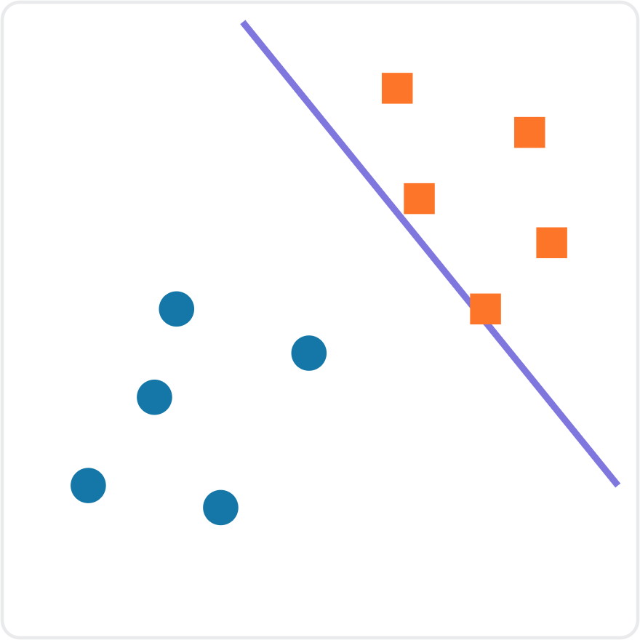
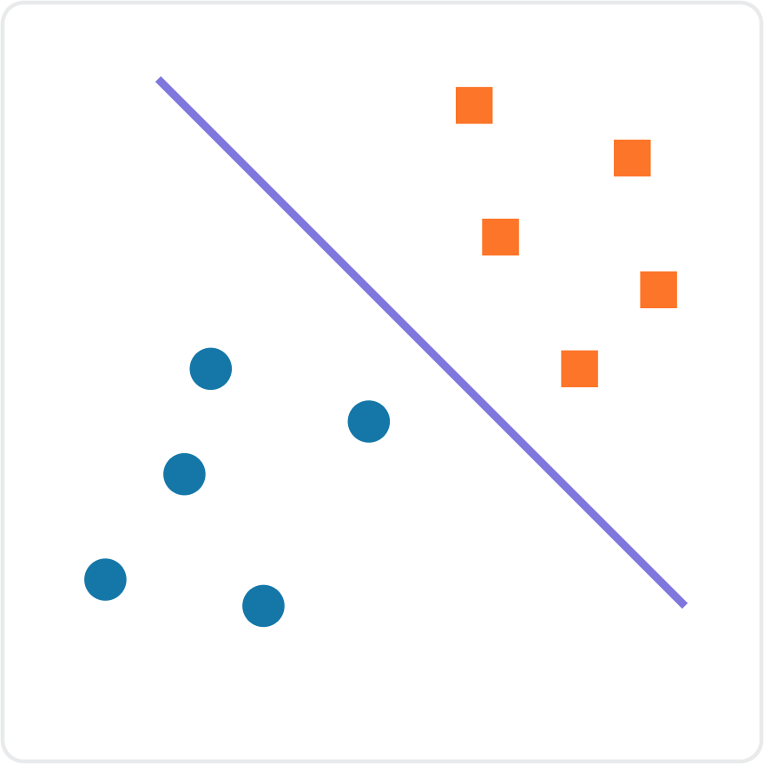
Both lines separate the data. Which one would you trust?
Step 1 · Maximum margin
Line A
Line B
Support vector machines · Practical machine learning
Notes:
Ask the class before revealing anything: both lines classify every training point correctly, so which one would you trust when a new point arrives near the boundary, and why? Expected answer: Line B, because it leaves room on both sides. Line A squeezes right past the squares, so a new square that lands slightly closer to the circles would be misclassified.

Slide 4
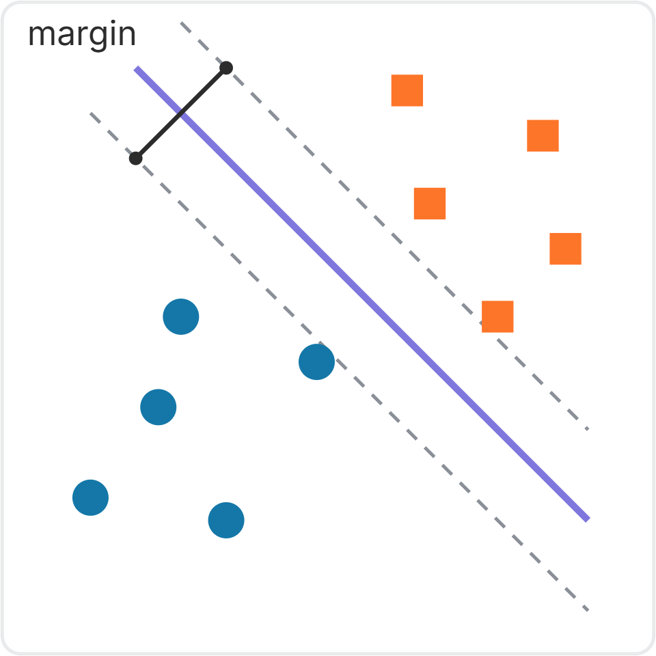
Choose the line with the widest gap
Step 1 · Maximum margin
The margin is the empty street between the two classes. The dashed lines are its edges.
A wide street leaves room for new points that differ slightly from the training data.
SVM's goal: find the line with the maximum margin.
A wider margin means the model generalizes better to unseen data.
Support vector machines · Practical machine learning
Notes:
Define margin as the width of the empty street. Then state the goal in one sentence: SVM finds the separating line with the maximum margin. Link it back to the previous slide: wider margin means more tolerance for new, slightly different data, and that is what generalizes better means.

Slide 5
In any number of dimensions, the boundary is a hyperplane
Step 1 · Maximum margin
1 feature
2 features
3 features
n features
A single point
A line
A flat plane
A hyperplane
SVM finds the maximum-margin hyperplane: the widest street, in as many dimensions as your data has features.
Support vector machines · Practical machine learning
Notes:
Students will meet the word hyperplane in every SVM resource, so name it now. It is just the general name for the dividing boundary: a point on a number line, a line on a plane, a flat sheet in 3D. With 20 features you cannot picture it, but it is still a flat wall splitting the space into two sides.

Slide 6
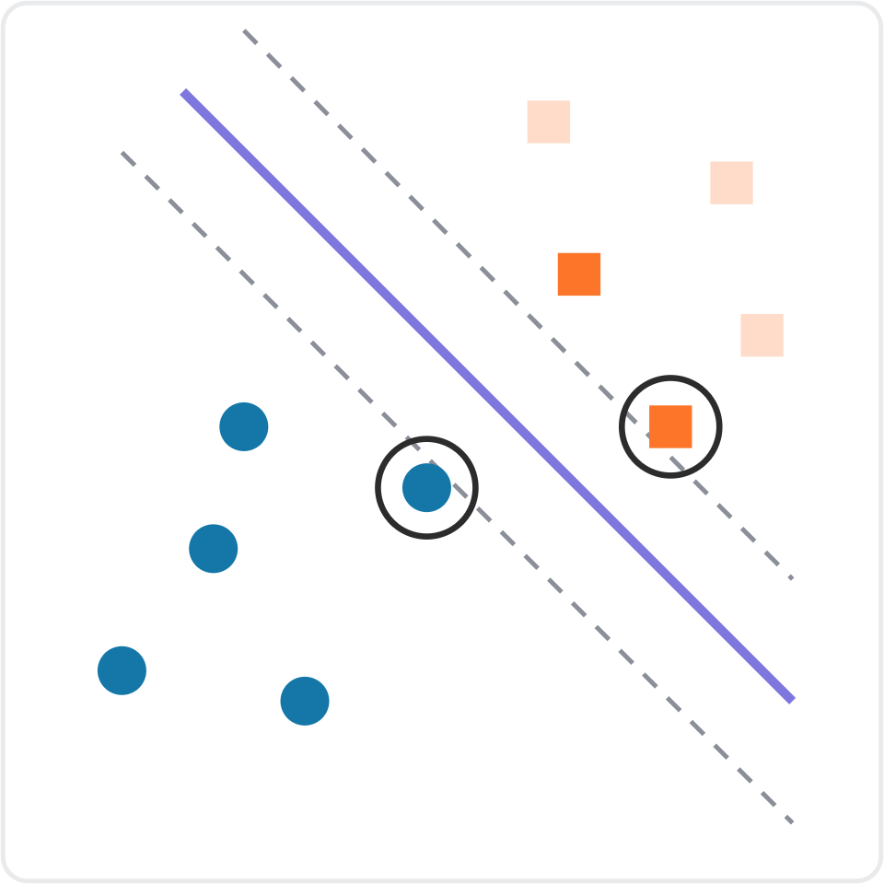
Only the points on the edge hold the line in place
Step 2 · Support vectors
The ringed points touch the edges of the margin. They are the support vectors.
Delete a faded point far from the street: the line does not move.
Move a support vector: the whole street shifts.
Support vectors support the line, like pillars holding up a beam.
Support vector machines · Practical machine learning
Notes:
Ask first: if we delete the faded squares in the top-right, does Line B move? Expected answer: no. Only the points touching the margin edges decide where the line goes. That is where the algorithm gets its name. Be precise: support vectors are the points on the margin edges, not just points that are close to the line.

Slide 7
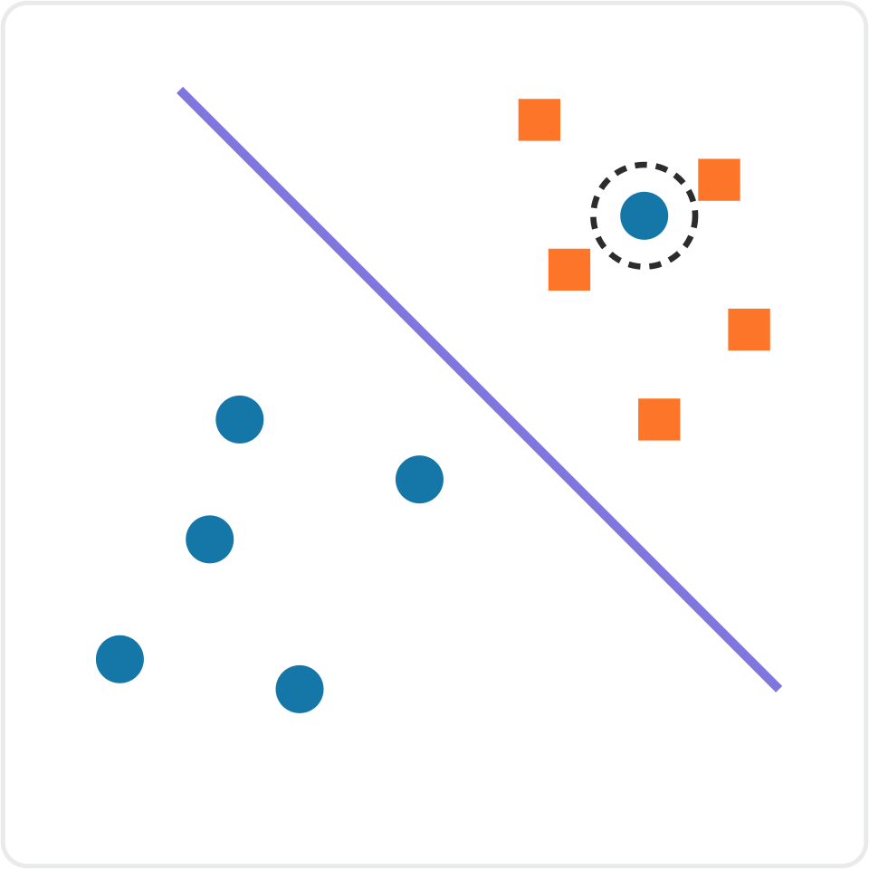
Real data is messy
Step 3 · Soft margin
One stray circle sits among the squares: perhaps noise, perhaps a labelling mistake.
Now no straight line separates the classes perfectly. Forcing a near-perfect split makes the street very narrow.
Discuss
Should SVM bend over backwards to classify this point, or accept it as a mistake to keep the wide street? What does each choice cost?
Support vector machines · Practical machine learning
Notes:
Let students argue both sides. Fitting the stray point costs margin and risks learning noise. Ignoring it costs one training error but keeps a wide, stable street. The honest answer is that it depends on whether the point is noise or a real pattern, which is exactly why SVM gives us a dial on the next slides.

Slide 8
Soft margin: allow a few mistakes, at a price
Step 3 · Soft margin
Allow
Penalize
Balance
Some points may sit inside the street, or even on the wrong side.
Every violation adds a penalty to what SVM is minimizing.
SVM trades off a wide street against a small total penalty.
A hard margin demands a perfect split. A soft margin is the default in practice, because real data is rarely perfectly separable.
Support vector machines · Practical machine learning
Notes:
Hard margin: no point may violate the street, which only works on perfectly separable data. Soft margin: violations are allowed but cost a penalty. SVM now has two goals that pull against each other, a wide street and few violations. The next slide shows the dial that sets the balance.

Slide 9
C sets the price of each mistake
Step 3 · Soft margin
 | Small C | Large C
Each mistake is | Cheap | Expensive
The street is | Wide | Narrow
Training errors | Some are tolerated | Very few are tolerated
Main risk | Underfitting (high bias) | Overfitting (high variance)
In scikit-learn, SVC(C=1.0) is the default. Tune C with cross-validation rather than guessing.
Support vector machines · Practical machine learning
Notes:
Ask: which setting of C risks overfitting, and why? Expected answer: large C. Mistakes are so expensive that SVM bends the boundary to fit every noisy training point, giving a narrow street tuned to the training data. Small C goes the other way and can underfit. C is the first SVM hyperparameter students will tune.

Slide 10
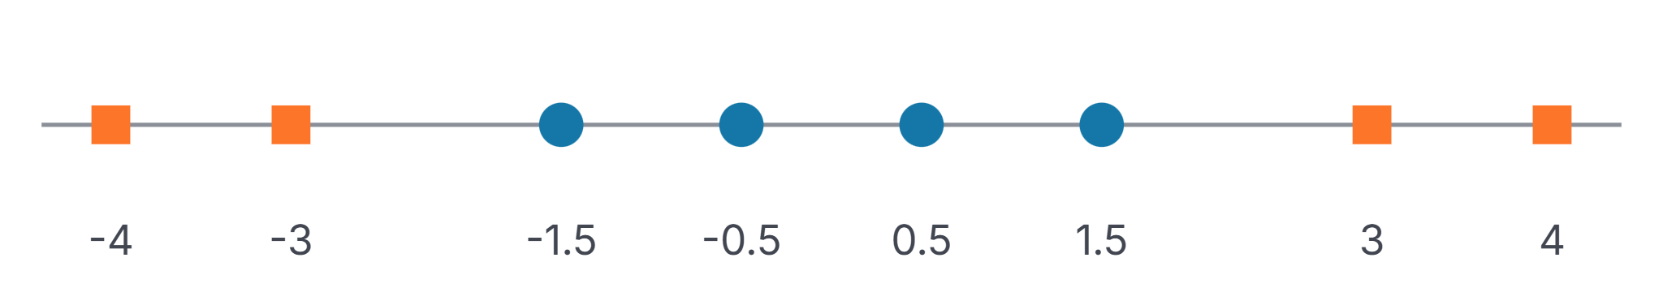
When no straight line can separate the data
Step 4 · Kernels
On a number line, the boundary is a single cut point. The squares sit at both ends, so no single cut can put all circles on one side and all squares on the other.
Support vector machines · Practical machine learning
Notes:
Ask: if each point could get a second coordinate computed from x, which formula would lift the outer squares high and keep the middle circles low? Accept x squared or the absolute value of x. Both work; x squared is the textbook choice and the one the next slide uses.

Slide 11
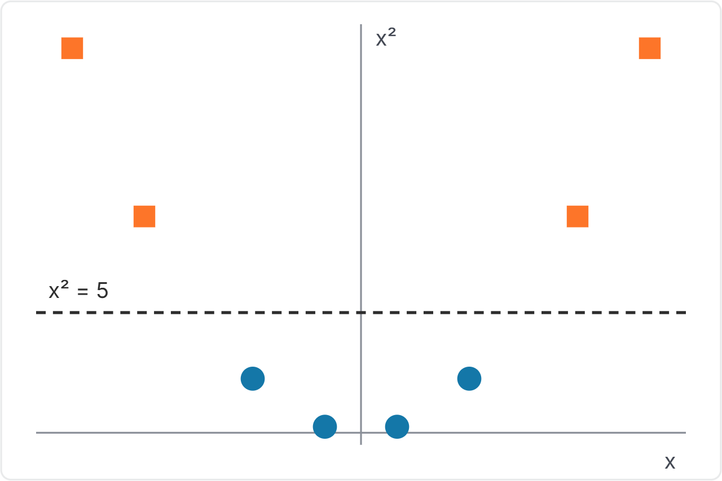
Add a feature: map each x to (x, x²)
Step 4 · Kernels
The squares rise high. The circles stay low.
A flat line at x² = 5 now separates them perfectly.
Back on the original number line, that line is two cut points: x = ±√5, about ±2.24.
The idea: if the data cannot be separated where it is, move it to a higher dimension where it can.
Support vector machines · Practical machine learning
Notes:
Walk through the numbers: the squares at plus or minus 3 and 4 land at heights 9 and 16, the circles at heights 2.25 and 0.25. A straight line in the new space corresponds to a curved, or here split, boundary in the original space. That is the core idea behind kernels. The next slides explain how SVM does this cheaply.

Slide 12
The dot product measures how alike two points are
Step 4 · Kernels
a · b = a₁b₁ + a₂b₂ Multiply matching coordinates, then add.
Compare a = (3, 1) with | Dot product | Direction | Meaning
b = (3, 2) | 9 + 2 = 11 | Same way | Similar
c = (1, −3) | 3 − 3 = 0 | Right angle | Unrelated
d = (−3, −1) | −9 − 1 = −10 | Opposite | Dissimilar
Read the sign, not just the size: large positive means similar, large negative means opposite.
Support vector machines · Practical machine learning
Notes:
Treat each point as an arrow from the origin. Let students compute the last row themselves before revealing it. Common mistake: reading minus 10 as big, therefore similar. The sign carries the meaning. Positive: pointing the same way. Zero: at right angles. Negative: pointing opposite ways.

Slide 13
Dot products are already inside SVM
Step 4 · Kernels
Which side of the street?
How SVM predicts
w · x + b
sign( Σ αᵢ yᵢ (xᵢ · x) + b )
Positive: one class. Negative: the other. Zero: on the boundary. The margin edges are where it equals +1 and −1.
Compare the new point x with each training point xᵢ. Each one votes for its class yᵢ, weighted by αᵢ.
The margin is the goal. The dot product is the tool SVM uses to reach it and to make predictions.
Support vector machines · Practical machine learning
Notes:
Students often ask: if SVM uses dot products, why did we study margins? Answer: they do different jobs. Maximizing the margin decides the weights alpha. The dot products do the comparing. Read the formula in plain words: the new point asks each training point how much am I like you, and each training point votes for its own class in proportion to the answer.

Slide 14
A trained SVM keeps only its support vectors
Step 4 · Kernels
αᵢ = 0
αᵢ > 0
For every point far from the street. It drops out of the sum.
Only for the support vectors, the points holding the street in place.
Example: train on 10,000 points and end up with 50 support vectors. Each prediction then needs 50 comparisons, not 10,000.
Support vector machines · Practical machine learning
Notes:
This ties step 2 to the formula. Alpha is how much each training point matters. Far-away points do not affect the line, so their alpha is zero. Support vectors are the only points with alpha greater than zero. The 10,000 and 50 numbers are an illustrative example, not a rule; the real count depends on the data and on C.

Slide 15
The kernel trick: the transformed dot product, without transforming
Step 4 · Kernels
Map each point: x → (x, x²)
Why it works
Dot product in the new space: (a, a²) · (b, b²) = ab + a²b²
Training points only ever appear inside dot products. Replace every xᵢ · x with K(xᵢ, x).
The margin, the support vectors and C all stay exactly the same.
Kernel: K(a, b) = ab + (ab)²
Uses only the original numbers a and b. No new coordinates are ever built.
Support vector machines · Practical machine learning
Notes:
Computing new coordinates gets expensive when the new space has hundreds of dimensions, or infinitely many in the case of RBF. The kernel computes the dot product those points would have in the new space directly from the original values. Show the algebra on the left line by line so students see that ab plus (ab) squared needs only a and b.

Slide 16
Kernels you will use in scikit-learn
Step 4 · Kernels
Kernel | What it does | Use it when
linear | No transformation | The data is roughly separable as it is
poly | Adds powers and products of features | You expect a smooth curved boundary
rbf (default) | Similarity falls off with distance | General-purpose curved or island-shaped boundaries
gamma (rbf): how far one point's influence reaches. Large gamma gives a wiggly boundary and risks overfitting, just like large C.
Support vector machines · Practical machine learning
Notes:
In scikit-learn these are SVC(kernel='linear'), 'poly' and 'rbf', with rbf as the default. Point out the parallel: C and gamma are both dials where turning them up fits the training data more tightly and risks overfitting. A natural lab exercise is to vary C and gamma on a small 2D dataset and plot the boundary.

Slide 17
SVM in four steps
Recap
01
Maximum margin
Of all separating hyperplanes, pick the one with the widest street.
02
Support vectors
Only the points on the street's edges decide where it goes.
03
Soft margin and C
Allow some mistakes; C sets how much each one costs.
04
Kernels
Compare points in a higher dimension, without building it.
Notes:
Read the chain aloud and ask a student to explain each step in their own words. Every step solves a problem raised by the one before it.

Slide 18
Answer in your own words
Check your understanding
Question 1
Question 2
Why does a wider margin generalize better to new data?
What happens to the boundary if you delete a point that is not a support vector?
Question 3
Question 4
Which setting of C risks overfitting, and why?
Why does SVM only need the support vectors to make a prediction?
Support vector machines · Practical machine learning
Notes:
Answers. 1: A wide street leaves room for new points that differ slightly from the training data, so small variations do not flip the prediction. 2: Nothing changes; only support vectors hold the line in place. 3: Large C, because mistakes become so expensive that SVM fits noise with a narrow street. 4: Every other point has alpha equal to zero and drops out of the decision rule, so predictions compare the new point only with the support vectors.

